Slide 1

Presentation Title
MINISTERUL EDUCAȚIEI
UNIVERSITATEA „DUNĂREA DE JOS” DIN GALAȚI
FACULTATEA ȘTIINȚA ȘI INGINERIA ALIMENTELOR
www.ugal.ro, www.sia.ugal.ro
STUDENT SCIENTIFIC COMMUNICATIONS SESSION, 2021
Sustainable Foods for a Safety Future: A Healthy and Quality Life Vision
Authors:

Slide 2
Agenda of the presentation
01
INTRODUCTION
02
MATERIALS AND METHODS
PARTNERSHIP FOR PERFORMANCE!
03
RESULTS AND DISCUSSION
04
CONCLUSIONS

Slide 3
INTRODUCTION
1

Slide 4
Introduction content
And some text and maximum 2 slides for introduction.
Insert your data
1
Insert your data.
2
Insert your data
3

Slide 5
OBJECTIVES
2

Slide 6
The concept
Please define the concept and objectives of the study – 1 slide.
Objective 1
Objective 2
Objectives
Objective 3
Objective 5
Objective 4

Slide 7
MATERIAL and METHODS
3

Slide 8
Materials and Methods
Materials
Please define materials used. In brief.
Methods
Please define, in brief, the methods used.

Slide 9
RESULTS and DISCUSSION
4

Slide 10
RESULTS and DISCUSSION
Insert your data and explanations

Slide 11
CONCLUSION and PERSPECTIVES
5

Slide 12
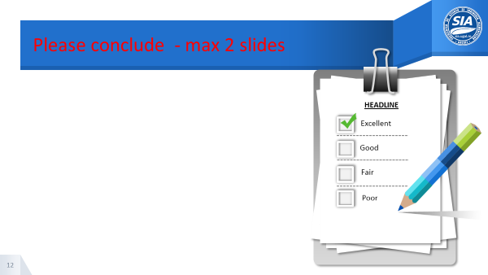
Please conclude - max 2 slides
HEADLINE
Excellent
Good
Fair
Poor

Slide 13

Thanks!
Any questions?
You can find me at:
@username
user@mail.ro
You can use your own photo from the labs

Slide 14
Acknowledgment
Special thanks if appropriate

